Slide 1
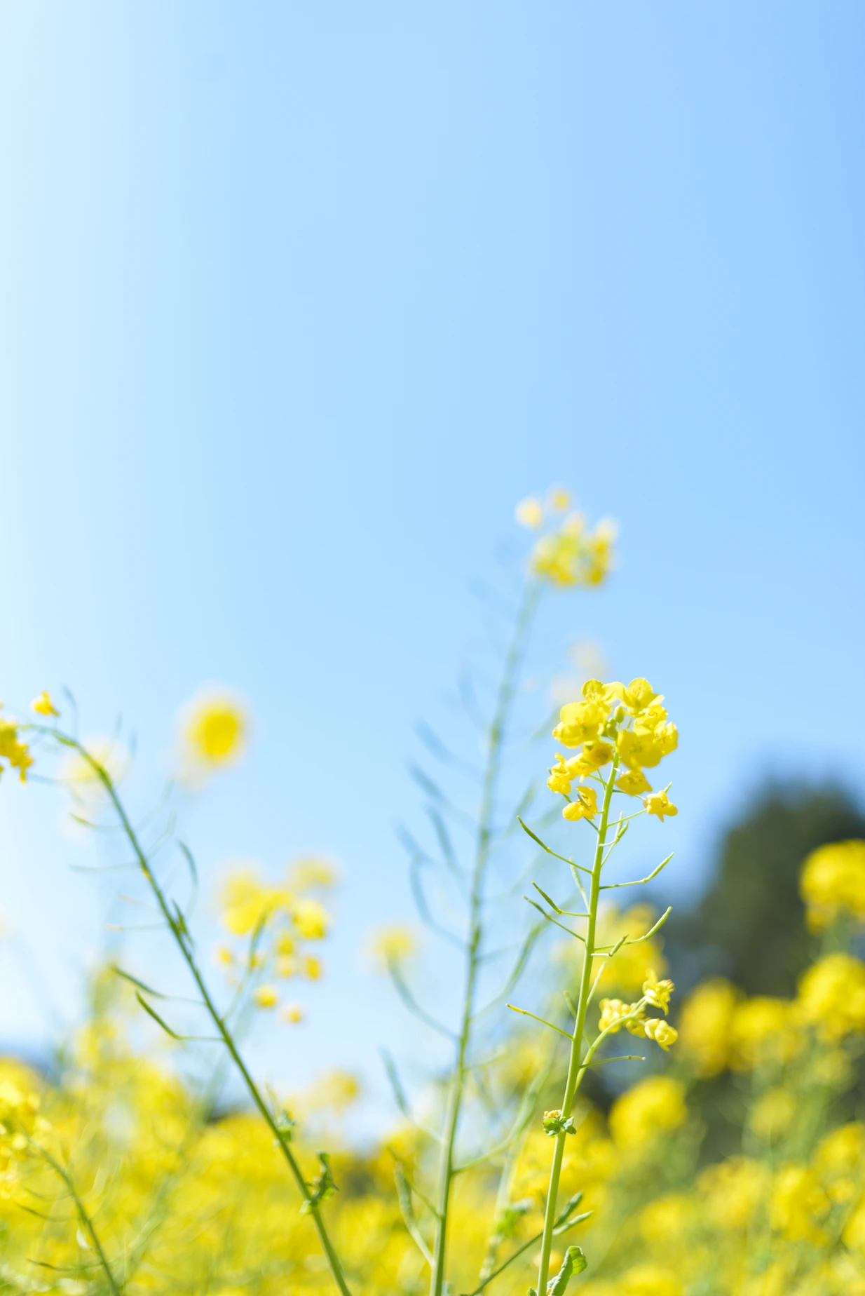
Reception Summer 1 News
We will be learning…
Maths |  | Phonics
Within maths, our focus is to practically solve problems involving multiplication and division Our little gems will practically solve problems involving doubles and halves. Our children will identify equal and unequal groups and understand that halving is the inverse of doubling. |  | In Phonics we will be covering the next set of sounds starting with ar,or,ur,ow,oi,ear,air,ure,er,and focus on this terms common exception words some,one,said,come,do,so,were,when,have ,there,out,like,little,what.
Science | RE/Our world |  | Topic
In Science, we will be discussing about dinosaurs and look closely on pictures of the natural world around us. | We will also find out how we can stay motivated to achieve a challenge and discuss about our dreams and aspirations. |  | Summer is just around the corner! We have a brilliant topic to kick start this half term with an excellent learning opportunity to inspire and motivate. It is all linked to Animal Antics!
Art | Writing |  | PE
We will also be learning about the use of masks and traditional clothes in art so we can recreate some images linked to our theme. Our Artist of the half term is Sorkari Douglas. | In writing, cchildren will be able to write factual sentences about the topic. Our little gems will be able to create their own narratives! |  | Reception PE is every Wednesday and Friday. Please remember to come to school wearing suitable clothing for the everchanging weather.
We will be encouraging the children to read every day. Please listen to your children read at home or access Bug Club.
Adults at Home: We need YOU!
We will be encouraging the children to read every day. Parents are asked to read with their children each night, if possible.Please listen to your children read at home and ask your child what sounds they have learned each week.
Within Reception, children are given homework on a weekly basis. This will include weekly spellings, words to learn and maths work.
Tapestry
Tapestry is an online journal to help record all the learning and fun of children's early years education. Log in to see some of your child`s special moments during the week
a
Early Bird
Breakfast Club continues to be available for all children from 7.30am. Classroom doors open at 8.30am where early morning activities begin. Children need to be in class by 8.45am.
You can contact us via info@vpaleeds.co.uk and follow us on Facebook and Twitter for regular updates!

